Slide 1
Seller guidance | K12 Buying Season Campaign deck
Deck Overview
Purpose: This deck positions Microsoft Education’s Hybrid Learning solutions for K-12 business decision-makers—both for the 2021 transition back to school and for the future.
Audience: The audience of this presentation is LOB decision-makers; this is not a technical conversation. Example titles to target include state/provincial/regional Department of Education, system leader, school leader, IT director/CTO.
Deck Usage Guidance
This deck introduces schools’ key needs and challenges while adapting to remote and hybrid learning and how Microsoft solutions can help meet them, including three value pillars around driving better learning outcomes with affordable devices, building teacher confidence, and protecting students and data online. The deck provides information about Windows 10 and Surface devices before transitioning information about how to get started.
For more information, contact Frank Chiappone.
Security Solutions
This deck addresses security and privacy in two of the sections: devices (slides 6-10) and a security and privacy section (slides 16-19).
The first section on security (slide 10) is about on-device security and privacy protections that are built into Windows 10. The section on all-up security and privacy is based on Microsoft Office 365 with Teams, which is free for schools. This last section primarily focused on meeting controls and admin policies.
Optional Slides
There is an optional privacy slide at the end of the deck that you can include, if useful. It might fit best after slide 19.
SELLER REFERENCE ONLY

Slide 2

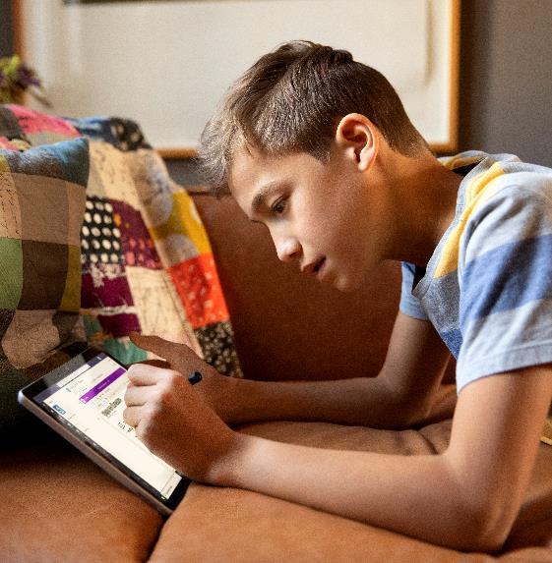

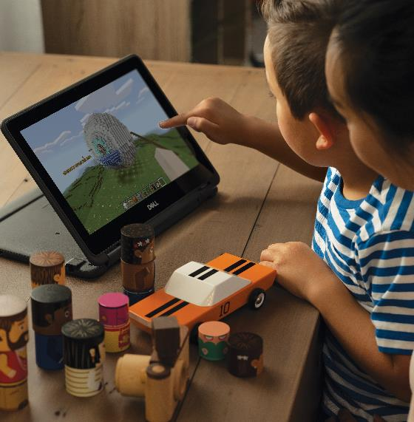
Empower students to learn anywhere

Slide 3
Remote learning presents new challenges
Managing Uncertainty
Building Teacher Capacity
Keeping Students Safe
Planning for an ever-changing mix of remote, hybrid, and in-person learning creates new challenges for school leaders and IT administrators
Managing a remote or hybrid classroom requires educators to develop new skills and knowledge to keep students engaged
Schools leaders need to provide safe environments while providing teachers with simple controls to manage their classrooms
Notes:
<Note to sellers: this slide is meant to elicit context-setting conversation and help shape the areas of focus for the rest of the deck>
2020 was a year of planned—and unplanned—changes for school leaders, educators, and students. Even after schools navigated the initial disruption due to COVID-19, they’ve had to confront a range of challenges as they managed day-to-day uncertainty and worked to build teaching capacity for remote and hybrid learning. As they year went on, school leaders and IT administrators also had to contend with an increase in the number of sophisticated digital threats targeting schools as teachers and students spent more time online.
What has your experience been this past year?
Where is your organization at today? How did you address the crisis?
How are you defining what comes next?
Do you expect to go back to the way things were, or are you considering new ways of learning in the future?
Wherever you are in the process, Microsoft is here to support your efforts throughout your journey. <click>

Slide 4
Hybrid learning is the future
Hybrid learning involves more than virtual classes—it is a holistic learning experience that enables all students to continue their education regardless of weather, transportation limitations, or other obstacles they may face.
An agile hybrid learning system requires:
Accessible and secure devices for students that enable learning
online and off
Training and resources for teachers so they can confidently engage students online
Easy-to-manage technology that keeps students safe and
school data secure
Notes:
At Microsoft, we’ve also been deeply impacted by the shift to remote work necessitated by the COVID-19 crisis, so we understand the challenges that come along with this situation—and we want to help however we can. Now that education is shifting into the long-term reality of hybrid learning, we want to help you build a foundation to help all students succeed. Hybrid learning involves much more than virtual classes—it is a holistic, reimagined learning experience that enables all students to continue their education regardless of global health crises, weather, transportation limitations, or other obstacles they may be facing.
Hybrid learning is multimodal and interactive, meaning that the ideal learning environment offers a diverse selection of tools and features to keep learners actively engaged. It’s both synchronous and asynchronous, meaning that assignment workflows and class teams and other methods of offline engagement are included in addition to live class sessions. And perhaps most importantly, hybrid learning is all about thoughtfully planned infrastructure. It’s not a temporary response to a crisis—it’s the new normal for education, and it’s the path schools must follow to succeed in the future.
As school leaders continue to reimagine learning while creating a more agile, hybrid system, three key areas of have emerged: ensuring student access to a consistent learning experience both in-person and remotely; providing professional development for teachers to build confidence in remote and hybrid teaching; and keeping students, teachers, and school data safe. <click>

Slide 5
Empower students to learn anywhere with Microsoft Education
Microsoft Education provides an effective, accessible, and secure platform to drive student success—whether students are at school, at home, or on the go.
Learning Outcomes
Teacher Training
Student Safety
Achieve better learning
outcomes with the best
devices for learning anywhere
Empower teachers to transform their classrooms with training, tools, and resources
Keep students safe and data secure with classroom controls and comprehensive security
Notes:
Microsoft Education is meeting schools around the world where they’re at on their hybrid learning journeys. We are helping schools achieve sustainable, systematic hybrid learning at scale, while recognizing the unique needs of specific learning communities. We are providing thousands of education users with affordable devices, offering free training for educators, and providing no-cost solutions that protect students online.
Let’s look at how Microsoft can help with some of the challenges schools are facing. <click>

Slide 6
Achieve better learning outcomes with the best devices for learning anywhere

Slide 7

Learn anywhere with devices built for remote and hybrid learning
Empower students with devices built for learning. Support multimodal learning with 2-in-1 laptops with touch and Windows Ink. Offer LTE connectivity to keep students connected.
Engage everyone with built-in accessibility tools.
Deliver personalized instruction with built-in tools that give students of all abilities independence and the opportunity to learn.
Secure devices and protect privacy.
Windows 10 is the most secure Windows ever, and includes built-in anti-virus, anti-malware, anti-phishing protection to protect students and educators.
Notes:
<Note to sellers: the third pillar in this section is focused on device security. Slides 16-19 address safety and security more broadly in Microsoft Education products>
Planning for an ever-changing mix of remote, hybrid, and in-person classrooms can be a challenge. Windows 10 puts innovative tools and personalized devices, built for both the classroom and remote learning, into the hands of educators and students. You can trust that students and teachers are always connected and prepared with devices trusted by more than a billion people around the world.
Windows 10 devices are built for learning. Deliver personalized learning with multi-modal 2-in-1 devices that combine pen, touch and type and built-in accessibility tools. Windows devices come with built-in accessibility tools, making it easier to deliver personalized instruction. And you can rest easy knowing that your devices are protected by comprehensive security with built-in anti-virus, anti-malware, and anti-phishing protection for students and teachers.
Let’s take a close look together. <click>

Slide 8
Empower students with devices built for learning anywhere
Help students engage with their teachers with a built-in noise cancelling microphone and a front-facing webcam
Keep students productive with cell-enabled devices that work online and offline
Unlock multi-modal learning and creativity with Windows Ink and the ability to draw, sketch, write, and take notes
Give students devices with all-day battery life so they can learn anywhere without interruption
Notes:
<Note to sellers: the features listed on this slide are not available on every Windows 10 device>
With schools closing around the world, remote and hybrid learning have become the most viable options for delivering educational experiences. With Windows 10 devices, students can engage online with their teachers via built-in noise cancelling microphones, front-facing webcam, and other USB connected devices.
Only 70% of students have broadband access at home¹, so schools can keep students connected with Windows 10 Education devices built with Qualcomm Snapdragon processors. These devices provide LTE cell technology so students can join online classrooms even if they have a home internet connection.
Plus with all-day battery life means students can work anywhere in the house without interruptions, and when they return in-person, they won’t have to worry about keeping a device plugged in.
With more time online, engaging students in different forms of learning is crucial. Devices with Windows Ink engage students in multi-modal learning to help unlock creativity and critical thinking. Students can use the digital ink pen to take notes in OneNote, Teams, or on the Microsoft Whiteboard app. They can also write essays in Word and draw in PowerPoint and Paint. Students can use a pen and Windows Ink across 10+ applications in their Windows 10 2-in-1 devices
Let’s take a deeper look at how Windows 10 devices support personalized learning with built-in accessibility tools.<click>
Reference:
1. Spring 2020 Remote Learning Survey Results, BrightBytes & ISTE, https://static1.squarespace.com/static/5716af60356fb068327b23af/t/5f1765c386d7e37c7f58d891/1595368908363/BrightBytes+2020+Remote+Learning+Survey+Results.pdf

Slide 9
Engage everyone with built-in accessibility
Microsoft builds accessibility directly into education solutions to enable personalized learning. Empower every student—regardless of their learning preferences—with a robust set of built-in features that work across remote, hybrid, and in-person classrooms.
Vision
Screen reading, speech-to-text, Seeing AI, Magnifier, and more
Hearing
Live captions and meeting transcriptions with translation
Mobility
Type with your voice or a pointing device, and click with your eyes
Neurodiversity
Immersive Reader, Focus Assist, and more tools to improve comprehension
Notes:
As you plan for the transition back to school, it’s more important than ever to ensure that learning and resources are accessible for all students, including both those with physical disabilities and those with invisible disabilities like dyslexia or ADHD. Microsoft builds accessibility directly into every solution, including products like Teams that promote all students to make their voices heard through text, voice, or video.
On this slide are just a few examples of built-in accessibility tools you can find across Windows 10 and Office 365 with Teams. You can activate live captions for meetings and events in Teams, or for PowerPoint presentations. Automatically generate searchable meeting transcriptions for students to review later, and leverage Accessibility Checker to make sure your presentations, documents, and more are accessible.
There are a plethora of features to make homework and studying accessible. Students can use the Ease of Access center to change content size, apply color filters, and more across Windows 10. Focus Assist turns off notifications for chat and email, Immersive Reader offers innovative tools to aid reading comprehension, and other tools include text-to-speech and dictation. Microsoft solutions are also designed for compatibility with assistive technologies like screen readers. <click>

Slide 10

Secure devices and protect privacy with comprehensive security
Block threats in the browser. Microsoft Edge offers the highest rated protection against phishing and malware attempts to help safeguard students online.¹
Protect privacy online. Ensure data is never sold to advertisers with clear privacy controls and ad-free search experiences with Microsoft Edge and Bing.
Defend devices from malware. Defend teachers and students from malware and viruses with Microsoft Defender Antivirus.
  Encrypt data on the device. Protect students against sensitive data theft or exposure from lost or stolen computers with BitLocker Drive Encryption.
References:
1. Microsoft Edge blocks more phishing and malware attempts than Chrome (NSS Labs)
Notes:
With students and teachers spending more time online, we know that student protection is top of mind for school leaders. With Microsoft, you can rest assured that your students are protected from threats and breaches by leveraging the same industry-leading technology we provide to our enterprise customers. For example, Windows 10 provides comprehensive, built-in protection—at no extra cost. Windows devices come with built-in security features, so your students are protected from the moment the power button is pushed.
Protection begins with BitLocker Drive Encryption so sensitive data is protected from theft or exposure from lost or stolen computers. Windows 10 devices come with built-in Microsoft Defender Antivirus to guard against malware and viruses. As students and teachers spend more time online, you can protect them with Microsoft Edge, which offers the highest rated protection against phishing and malware attempts. When combined with ad-free search on Bing, you can ensure that data is never sold to advertisers.
Your technology and devices are nothing without the teachers, so let’s take a look at how Microsoft is supporting teachers right now.<click>
References:
https://www.nsslabs.com/tested-technologies/web-browser-security-wbs/
https://edgeconsumerproduction.blob.core.windows.net/hostingdocs/NSS_Labs_Browser_Phishing_Report_Q2_2020.pdf
https://edgeconsumerproduction.blob.core.windows.net/hostingdocs/NSS_Labs_Browser_Malware_Report_Q2_2020.pdf

Slide 11
Empower teachers to transform their classrooms with training, tools, and resources

Slide 12
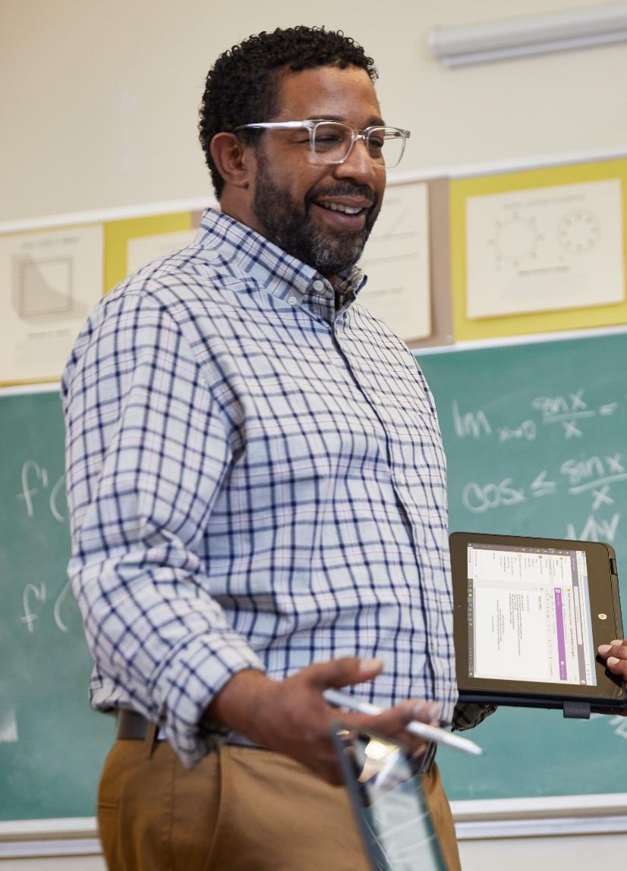


Ensure teacher readiness for any type of learning
Build confidence. Prepare teachers for remote learning with free training on the Microsoft Educator Center and support from Microsoft Store specialists.
Personalize learning. Support a student-centered approach to learning across remote, hybrid, and in-person environments, centralized in Microsoft Teams.
Streamline collaboration. Build professional learning communities and help teachers stay connected with Microsoft Office 365 and Teams.
Notes:
When schools shifted to remote learning in March 2020, more than half of K-12 teachers said they were not prepared to facilitate remote learning.¹ A critical need for school leaders, and the one most closely tied to better learning outcomes, is providing teachers with the training and best practices they need to build confidence and skills in remote and hybrid teaching. Microsoft Education provides teachers with free training, professional development, and tools they need to transform their classrooms. <click>
References:
“Most Teachers Say They Are ‘Not Prepared’ To Teach Online” (Forbes) https://www.forbes.com/sites/dereknewton/2020/03/26/most-teachers-say-they-are-not-prepared-to-teach-online/#3bb086b27f2c

Slide 13

Build teacher confidence with training and resources
Learn new skills. Master classroom technology and create an inclusive hybrid learning environment with free courses on Microsoft Educator Center.
Complete certifications. Take guided learning paths on Microsoft Educator Center to earn certifications and complete professional development credits.
Get personalized assistance. Engage Microsoft Store experts to provide customizable and interactive live virtual workshops and training sessions.
Notes:
Schools leaders can build educator confidence and capacity for remote and hybrid learning with free training and resources. Educators can access the Microsoft Education Center for a wide variety of free courses and learning paths to help master classroom technology and create an inclusive hybrid learning environment. Teachers can track professional skills development and get awarded badges, certificates and transcripts. Microsoft Store associates are also available for live virtual workshops and training sessions, providing schools and teachers with a customizable and interactive learning experience. <click>

Slide 14
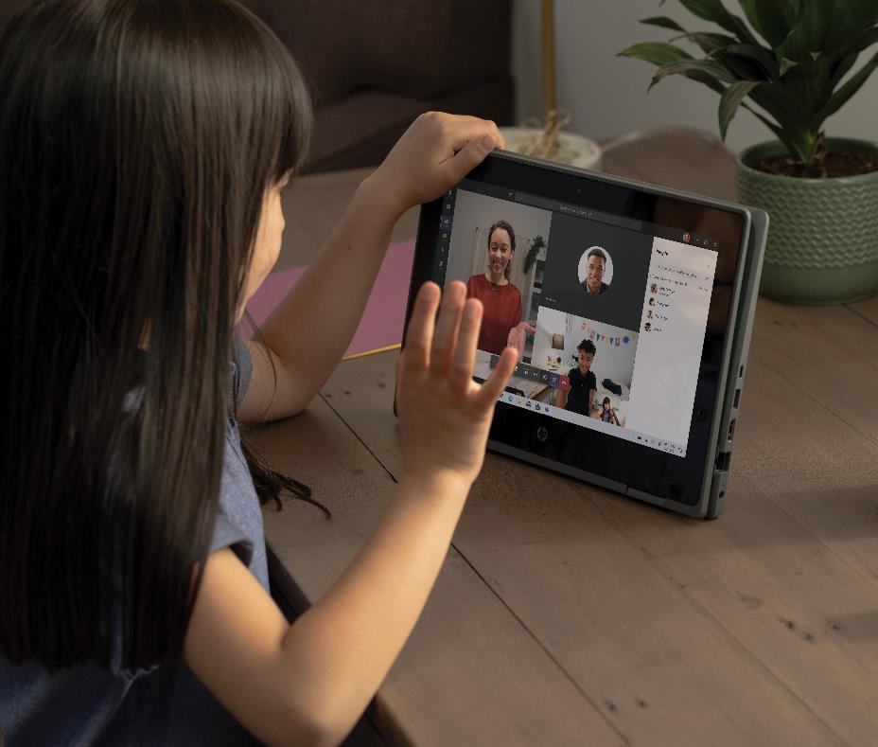
Enable inclusive learning in one place with Microsoft Teams
Create collaborative classrooms. Help teachers create a multi-modal, safe and engaging experience to support learners whether they’re at home or in the classroom.
Improve student outcomes. Personalize learning by assigning tailored lessons and providing transparent feedback in a single system.
Engage everyone in learning. Support students of all abilities with accessibility tools, live caption translation, Immersive Reader, and more.
Access all the tools you need in one place. Integrate with apps, including Learning management systems (LMS), to manage assignments, track grades, and more.
Notes:
In any classroom, it’s important that teaching and learning come first. Microsoft Teams is the new place that brings conversations, content, assignments, and apps together in one place. It is purpose-built for Education and customized for the way schools collaborate. In Teams, you can:​
​
Create collaborative classrooms that engage students in multi-modal, inclusive, and safe spaces. It’s easy to personalize learning by assigning tailored lessons and providing transparent feedback with tools integrated with your learning management system (LMS). And most importantly, you can engage everyone in learning with built-in accessibility tools like live caption translation and immersive reader. <click>

Slide 15
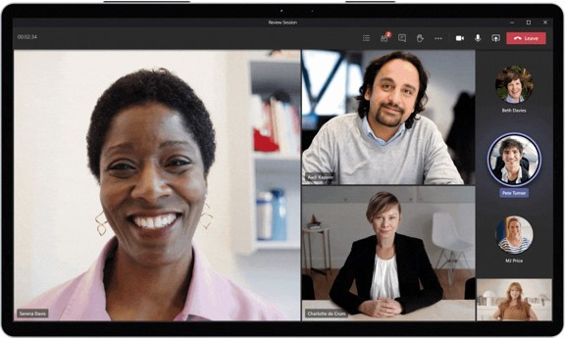
Streamline collaboration and build professional communities
Collaborate on documents. Work together on shared documents like Word, PowerPoint, and Excel, all in Microsoft Teams.
Gather in virtual spaces. Work together in a virtual classroom, auditorium, or coffeeshop with Together Mode so you feel like you’re in the same room.
Build professional communities. Teams for Education includes templates for professional learning communities and staff teams to help educators support each other.
Notes:
A key lesson learned last spring was that developing a community of support between fellow teachers was critical to developing best practices, solving problems, and providing the confidence needed to venture into the new world of remote learning. Whether remote learning is a mandate of the short term or a part of the educational experience of the future, the lesson here is important: helping teachers support teachers pays massive dividends for everyone⁴.
In addition to helping students, Microsoft Office 365 Education with Microsoft Teams offers powerful collaboration, communication, and project-based learning tools that help teachers stay connected both with students and with their peers. Teachers can easily work together on shared documents like Word, PowerPoint, and Excel, all within Teams.
With templates for professional learning communities in Microsoft Team, you can connect educators to improve teaching skills and support student outcomes. Keeping information flowing staff is critical during times of change, and Teams helps to streamline staff communication on school-wide initiatives within a single tool, whether it’s running a staff meeting or sharing an update across a school or a district. <click>

Slide 16
Keep students safe and data secure in online classrooms during remote and hybrid learning

Slide 17

Keep students safe and data secure
Maintain safety. Setup safe and secure online classes in Microsoft Teams and minimize classroom disruptions with controls for teachers.
Safeguard data and privacy. Secure identities, apps, data, and devices to create a safe environment, wherever learning takes place.​
Notes:
The increase in both the number of devices and the amount of time those devices are online has made schools more susceptible to attacks and disruptions within the remote learning environment. Such attacks have consequences to both student learning and their social and emotional well-being. Recent research shows that only 49% of teachers feel their students are safe in a remote learning environment.
Keep students safe and data secure with classroom controls for teachers and administrators for remote meetings, backed by industry-leading security to guard your data and privacy online. <click>
Reference:
“Let’s talk digital health & safety and return to school” https://www.linkedin.com/pulse/lets-talk-digital-health-safety-return-school-mark/?published=t

Slide 18

Maintain student safety with controls for meetings
Meeting options
Manage discussion with hard audio mute and the ability for students to request to speak
Control who can present during class or bypass the meeting lobby
Manage when students enter and leave with student lobby and end meeting for all participants
Admin policies
Apply global remote learning policy settings to easily manage safety settings
Set who can present in meetings with a default global administrative policy
Control the use of custom backgrounds in meetings with pre-set selections
Notes:
Online learning can present unique student safety challenges, from classroom disruptions to data breaches. Teams offers controls for teachers and administrators to protect students. Teachers can manage their classrooms with features like hard audio mute, which silences everyone until they request to speak. They can also control when students enter and leave a class with the student lobby and set who can present during class.
Teams offers robust policy and security settings that administrators can apply globally with pre-configured options that are easy to mange. Administrators can set global options for custom background, defaults for presenting, and more. In addition, Teams is Tier-D compliant, and it’s built on Azure, which has over 90 compliance certifications. You retain precise control over team naming, expiration, and permissions. <click>

Slide 19

Have confidence students are protected with industry-leading security
Identity management. Enable multi-factor authentication to secure your school against breaches due to lost or stolen credentials.
Defend against malicious threats. Protect students and educators from threats in emails, links, and collaboration tools with Microsoft Defender for Office 365.
  Manage identity access policies. Microsoft Intune for Education makes it easy to manage users, data, and devices with a single dashboard.
Have confidence apps are safe. Windows 10 apps are curated and proactively checked for dangerous code before they enter the store.
Notes:
Finally, Office 365 includes comprehensive security features, from advanced threat protection to identity management. Microsoft Office 365 includes tools for managing multi-factor authentication, backed by Azure, and cloud-based services to detect threats in emails, links, and collaboration tools like Microsoft Teams. Tools like Microsoft InTune streamline the process of managing users, data, and devices with modern remote deployment solutions. And you can always rely on Microsoft’s protection across the Windows app store and regular updates. <click>

Slide 20

Microsoft provides support throughout your journey
1,000+
free learning paths to help teach technology skills
400+
engineers building education-
specific technologies
$1.2B+
in software and services donated to 90,000+ nonprofits
150M+
students, faculty, and teachers using Microsoft Education products worldwide
110+ nonprofits
in partnership with Microsoft to reach millions of learners
Notes:
As we all navigate what comes next in 2021 and beyond, Microsoft is here to support your efforts throughout the journey. Microsoft has been a philanthropic and strategic partner to schools and universities for decades. Between diverse offerings for learning and skills development, millions of dollars donated toward education-focused nonprofits, and proven thought leadership, we’re invested in education now and for the future. As schools adjust to the reality of hybrid learning, we’re maintaining and expanding our education investments, and we remain deeply committed to our mission of empowering every student on the planet achieve more. <click>

Slide 21

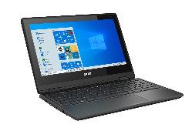
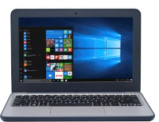





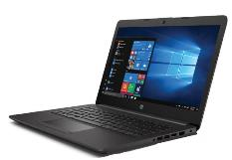
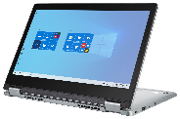
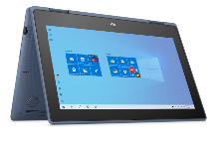




Find the right devices for your school slide 1
Image Coming Soon
Acer TravelMate B1/B1 Spin | Acer TravelMate B3/B3 Spin | Asus NEW Devices Coming Soon | Asus VivoBook W202
Intel: $259+ | Intel: $239+ |  | Intel: $199+
HD
Dell Latitude 3190/3190 2-in-1 | Dell Latitude 3310/3310 2-in-1 | HP Stream 11 Pro G5 EE | HP ProBook x360 11 EE G6 | HP 245 (AMD)
Intel: $249+ | Intel: $299+ | Intel: $239+ | $329+ | AMD: $329+
HD
HD
HD
HD
FHD
All day battery life | Rugged Design | Fast Resume | Windows Hello option | USB type C | Good to Go indicator | Touch display option | Quality Mic | HD Camera | FHD Camera | Cellular option | Pen Garage & Charging | Windows Ink Option
All specifications are subject to change without notice. Please check with each distributor for exact offers. Products may not be available in all markets.
Displayed prices are current lowest prices offered by stated distributors and are subject to change. Prices are not offered by Microsoft unless stated.
Classified as Microsoft Confidential – Microsoft Internal Only – Do Not Share
Notes:
Starting at just $219, Windows 10 devices are the safest and best devices for remote and hybrid learning. Here’s a selection of some of the great devices built by our partners and designed for education. <click>

Slide 22
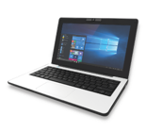
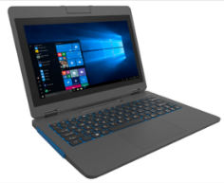
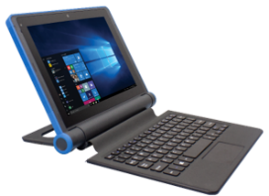
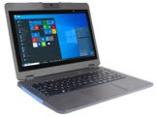
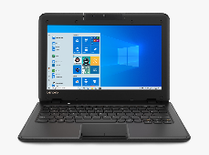
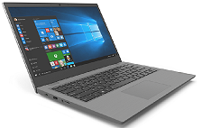
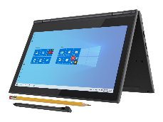
Find the right devices for your school slide 2
JP-IK Leap T304 | JP-IK Turn Connect T101 | JP-IK Turn T303 | JP-IK Slide S301
Intel: $185+ | Qualcomm: $329+ | Intel: $239+ | Intel: $219+
HD
HD
HD
HD
Image Coming Soon
Lenovo 14W | Lenovo 100e | Lenovo 300e | Lenovo NEW Device Coming Soon
AMD: $329+ | AMD: $229+ | AMD: $279+
HD
HD
HD
HD
FHD
All day battery life | Rugged Design | Fast Resume | Windows Hello option | USB type C | Good to Go indicator | Touch display option | Quality Mic | HD Camera | FHD Camera | Cellular option | Pen Garage & Charging | Windows Ink Option
All specifications are subject to change without notice. Please check with each distributor for exact offers. Products may not be available in all markets.
Displayed prices are current lowest prices offered by stated distributors and are subject to change. Prices are not offered by Microsoft unless stated.
Classified as Microsoft Confidential – Microsoft Internal Only – Do Not Share

Slide 23

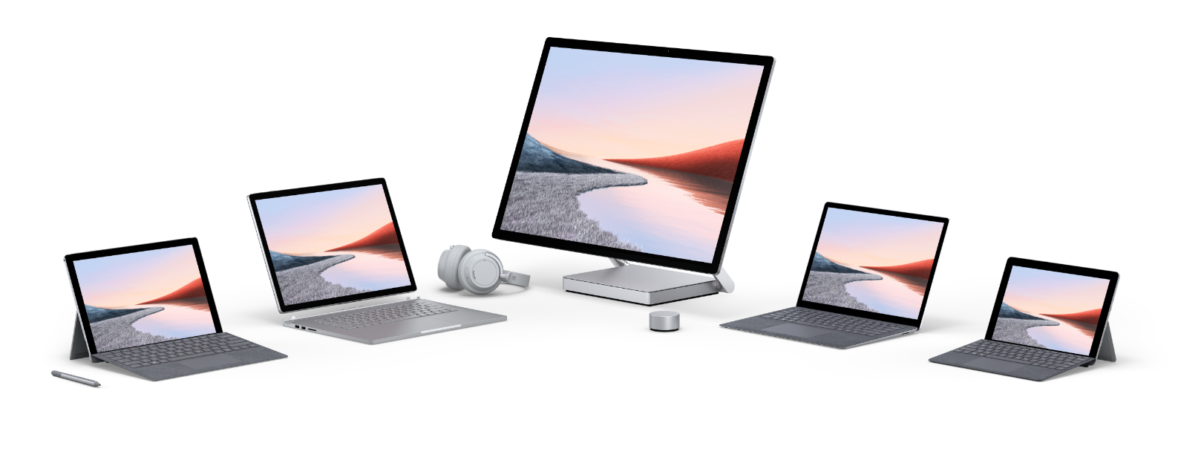
Meet the Surface family of devices
Microsoft offers a portfolio of Surface devices with touch and inking for more experiential and accessible learning, plus LTE options—so that students and faculty have the tools they need at school, at home, or on the go.
Hub
Provide multi-modal devices with long-lasting battery, HD cameras, laptop-to-tablet switching, and touch screens
Empower students to take notes, use inking,
and collaborate creatively from anywhere
Enable instructors to easily work from home
and connect with peers and students
Studio
Book
Laptop
Pro
Go
Notes:
95% of Fortune 500 companies use Windows, and Surface devices offer the best Windows experience to prepare students for their future work life. The family of Surface devices includes tablets, laptops, desktop, and the Surface Hub for classroom use. Designed to flexibly meet the needs of students and educators, Surface devices offer touch and inking for more experiential and accessible learning, plus LTE options so that you can connect to the Internet on the go.
​
Surface devices have long-lasting battery, HD cameras, and cutting-edge inking capabilities with the Surface Pen. Certain models can switch between tablet mode and laptop mode to fit different scenarios. Optimized for use with Office 365 tools, Surface devices help students engage creatively and enable instructors to easily collaborate—no matter where they are. And you can depend on built-in security at both the device and OS layers. Surface devices include firmware TPM Enterprise-grade protection with Windows Hello face sign-in, as well as Windows 10 Pro security to protect valuable data. <click>

Slide 24
Affordable and safe devices with free training
Starting at just $219, Windows 10 devices are the safest and best devices for remote and hybrid learning and come with free professional development with purchase of 15-300 eligible Windows 10 devices for your school.¹
Affordable devices
Free professional development
Special licensing pricing
Help to enable access for all students with affordable Windows 10 devices, built for both the classroom and remote learning, starting at $219
Build confidence in remote teaching and learning with free training, tools, live workshops, and professional development.
Get special education pricing when you purchase more than 1,000 devices with the Shape the Future Program² and with the Surface pricing licensing offer³.
¹Free teacher training offered with purchase of 15-300 eligible Windows 10 Education devices for your school. See details.
²Special Windows licensing pricing when you purchase more than 1,000 devices. Check eligibility.
³Surface pricing licensing offer available when you purchase more than 1,000 devices. Check eligibility.
Notes:
We’re also offering special licensing prices through the Shape the Future program for school and districts purchasing more than 1,000 devices. <click>

Slide 25

Next steps
Find the right devices for your school
Explore Windows and Surface devices
Contact Microsoft specialists for assistance
Roll out Microsoft Office 365 with Teams
Get started with Office 365 and Teams at no cost
Explore resources and best practices for Microsoft Teams
Explore training and resources
Browse free training on the Microsoft Educator Center
Request private training for your school or institution
Notes:
Here are some practical next steps to get started today. Remember that Office 365 A1 with Teams is available to your school for free, and Microsoft offers a plethora of online training and support options to help you through every step of deployment. <click>

Slide 26

Closing Slide
© 2020 Microsoft Corporation. All rights reserved. Microsoft, Windows, and other product names are or may be registered trademarks and/or trademarks in the U.S. and/or other countries.
The information herein is for informational purposes only and represents the current view of Microsoft Corporation as of the date of this presentation. Because Microsoft must respond to changing market conditions, it should not be interpreted to be a commitment on the part of Microsoft, and Microsoft cannot guarantee the accuracy of any information provided after the date of this presentation. MICROSOFT MAKES NO WARRANTIES, EXPRESS, IMPLIED OR STATUTORY, AS TO THE INFORMATION IN THIS PRESENTATION.
Notes:
Thank you.

Slide 27
Keep student data private and ensure data is never sold to advertisers
Optional slide
Microsoft believes privacy is a fundamental right and will never share or use student data for marketing, advertising, or other commercial purposes
Windows 10 provides clear privacy settings and controls so schools can easily set up the security and protection they need
Microsoft Edge, the default Windows browser, supports an ad-free Bing search experience for K-12 students
CBS News
Google secretly monitors millions
of schoolkids, lawsuit alleges¹
February 2020
Washington Post
Wired
Arizona sues Google over allegations it illegally tracked users’ locations²
Over a Billion Android Devices Are at Risk of Data Theft³
August 2020
May 2020
References: 1. CBS News 2. Washington Post 3. Wired
Notes:
<Note to sellers: this is an optional slide that can be included if you want to directly address privacy in a presentation>
Privacy is critical in enabling a secure and safe learning environment for your students and teachers.​ Microsoft believes privacy is a fundamental right and is dedicated to helping you create a safe and engaging learning environment, meet privacy standards, and ensure continuous compliance for your institution.​ Microsoft believes in six key privacy principles, and uses these to shape the way they build their products and services, especially for education​:
Control: We will put you in control of your privacy with easy-to-use tools and clear choices.​
Transparency: We will be transparent about data collection and use so you can make informed decisions.​
Security: We will protect the data you entrust to us through strong security and encryption.​
Strong legal protections: We will respect your local privacy laws and fight for legal protection of your privacy as a fundamental human right.​
Benefits to you: When we do collect data, we will use it to benefit you and to make your experiences better.​
No content-based targeting: We will not use your email, chat, files or other personal content to target ads to you.
<click>

